Slide 1
Real-time Participant Feedback to Improve the Clinical Research Enterprise: Collaborative Infrastructure and Validated Tools
Project PI: Rhonda G. Kost, MD

Slide 2
Support
Empowering the Participant Voice: Collaborative Infrastructure and Validated Tools for Collecting Participant Feedback to Improve the Clinical Research Enterprise is supported in part by a Collaborative Innovation Award from the National Center for Accelerating Translational Science #U01TR003206 to the Rockefeller University, and by Clinical Translational Science Awards UL1TR001866 (Rockefeller University), UL1TR002553 (Duke University), UL1TR003098 (Johns Hopkins University), UL1TR002001 (University of Rochester), UL1TR002243 (Vanderbilt University), and UL1TR001420 (Wake Forest University Health Sciences).
Supported in part by NIH/NCATS Grant # U01TR003206

Slide 3
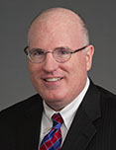
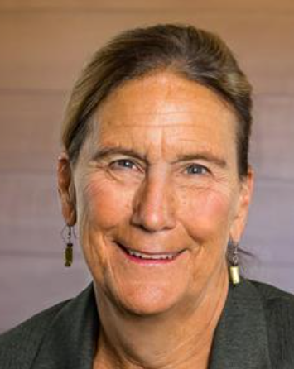
Site Principal Investigators
Rhonda G. Kost, MD Project PI
Associate Professor of Clinical Investigation
Center for Clinical and Translational Science
Paul Harris
PhD
Professor,
Director of
Biomedical Informatics
Joseph E. Andrews, Jr.
PhD, MA, CIP, CCRP
Assistant Dean for Regulatory Affairs and Research Integrity at Wake Forest School of Medicine.
Ann M. Dozier
RN, PhD, FAAN Professor and Chair, Department of Public Health Sciences
Albert D. Kaiser Chair of Public Health and Preventive Medicine
h
Daniel Ford
MD, MPH Vice Dean for Clinical Investigation, Johns Hopkins School of Medicine
Director, Institute for Clinical and Translational Research
Ranee Chatterjee-Montgomery MD
Associate Professor of Medicine
Duke Clinical and Translational Science Institute

Slide 4
Agenda
Welcome & Introductions
Project Overview
Implementation
Q&A
Notes:
Welcome 1 min
Quick framing - 1 min
Introductions – collaborators, those in discussions, those new to us 2 min
As each site lead to introduce themselves and team and what you most hope to learn today….

Slide 5
Why Survey Research Participants with RPPS?
Is consent effective?
Are participants having a positive experience?
How to improve recruitment?
How to improve retention?
Are different groups of participants have different experiences?
What is the experience of minorities and underrepresented groups?
How effective or impactful are current engagement, recruitment, etc. initiatives?
Asking participants builds trust
Engaging communities in acting on results builds trust
Identify high performance/best practices
Identify opportunities to improve research
How do we compare to other sites? Are there common opportunities across the Consortium?
Supported in part by NIH/NCATS Grant # U01TR003206
Notes:
When we engaged a broad group of stakeholders, each group has priorities about what they want to learn form participant feedback, and what they are afraid of…..These all can be managed, locally, which is why it is important o engage stakeholders from the get go and keep them with you throughout the project.

Slide 6
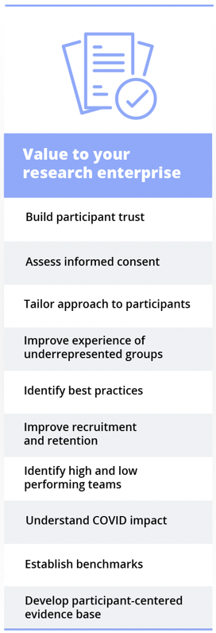
Supported in part by NIH/NCATS Grant # U01TR003206
Notes:
When we engaged a broad group of stakeholders, each group has priorities about what they want to learn form participant feedback, and what they are afraid of…..These all can be managed, locally, which is why it is important o engage stakeholders from the get go and keep them with you throughout the project.

Slide 7
Value Proposition
Why haven’t we all done it already?
which survey?
which participants?
how to sample?
how to send?
when to send?
how to analyze data?
what do the scores mean?
are there any benchmarks?
how to use the data?
Notes:
We set out to fix this…..

Slide 8
EPV Project Aims
Specific Aims:
1. Develop a novel Research Participant Perception Survey/REDCap (RPPS/REDCap) collaborative infrastructure, tools, and standard implementation models.
2. Demonstrate that the collaborative RPPS/REDCap infrastructure and implementation model is an effective approach to collect local and national benchmarks and actionable data.
3. Disseminate the infrastructure, catalyze research-on-research and transform evaluation by empowering the participant voice.
Supported in part by NIH/NCATS Grant # U01TR003206

Slide 9
Supported in part by NIH/NCATS Grant # U01TR003206
Notes:
Vision…..

Slide 10
EPV Project Aims
Specific Aims:
1. Develop a novel Research Participant Perception Survey/REDCap (RPPS/REDCap) collaborative infrastructure, tools, and standard implementation models.
2. Demonstrate that the collaborative RPPS/REDCap infrastructure and implementation model is an effective approach to collect local and national benchmarks and actionable data.
3. Disseminate the infrastructure, catalyze research-on-research and transform evaluation by empowering the participant voice.
Supported in part by NIH/NCATS Grant # U01TR003206

Slide 11
Progress to date…
Engaged stakeholders at each site throughout
Developed consensus on standards – what is standard, what is flexible
Developed local Use Cases
Built tools and infrastructure
RPPS – Short – P – English, Spanish, action tags for multilingual module
Data capture forms – participant and study descriptors
External module – multi-lingual fielding
External module – data piping from study project to RPPS project
External module – At-a-Glance Dashboard, local and national views
Implemented Infrastructure
Implemented Use Cases (different at each site)

Slide 12
RPPS-Short survey asks about…
Informed consent
Listening/courtesy/respect
Feeling valued
Language/culture/privacy
Communication with team
Rate the Overall research experience
Would you recommend to friends and family
Demographics
Supported in part by NIH/NCATS Grant # U01TR003206

Slide 13
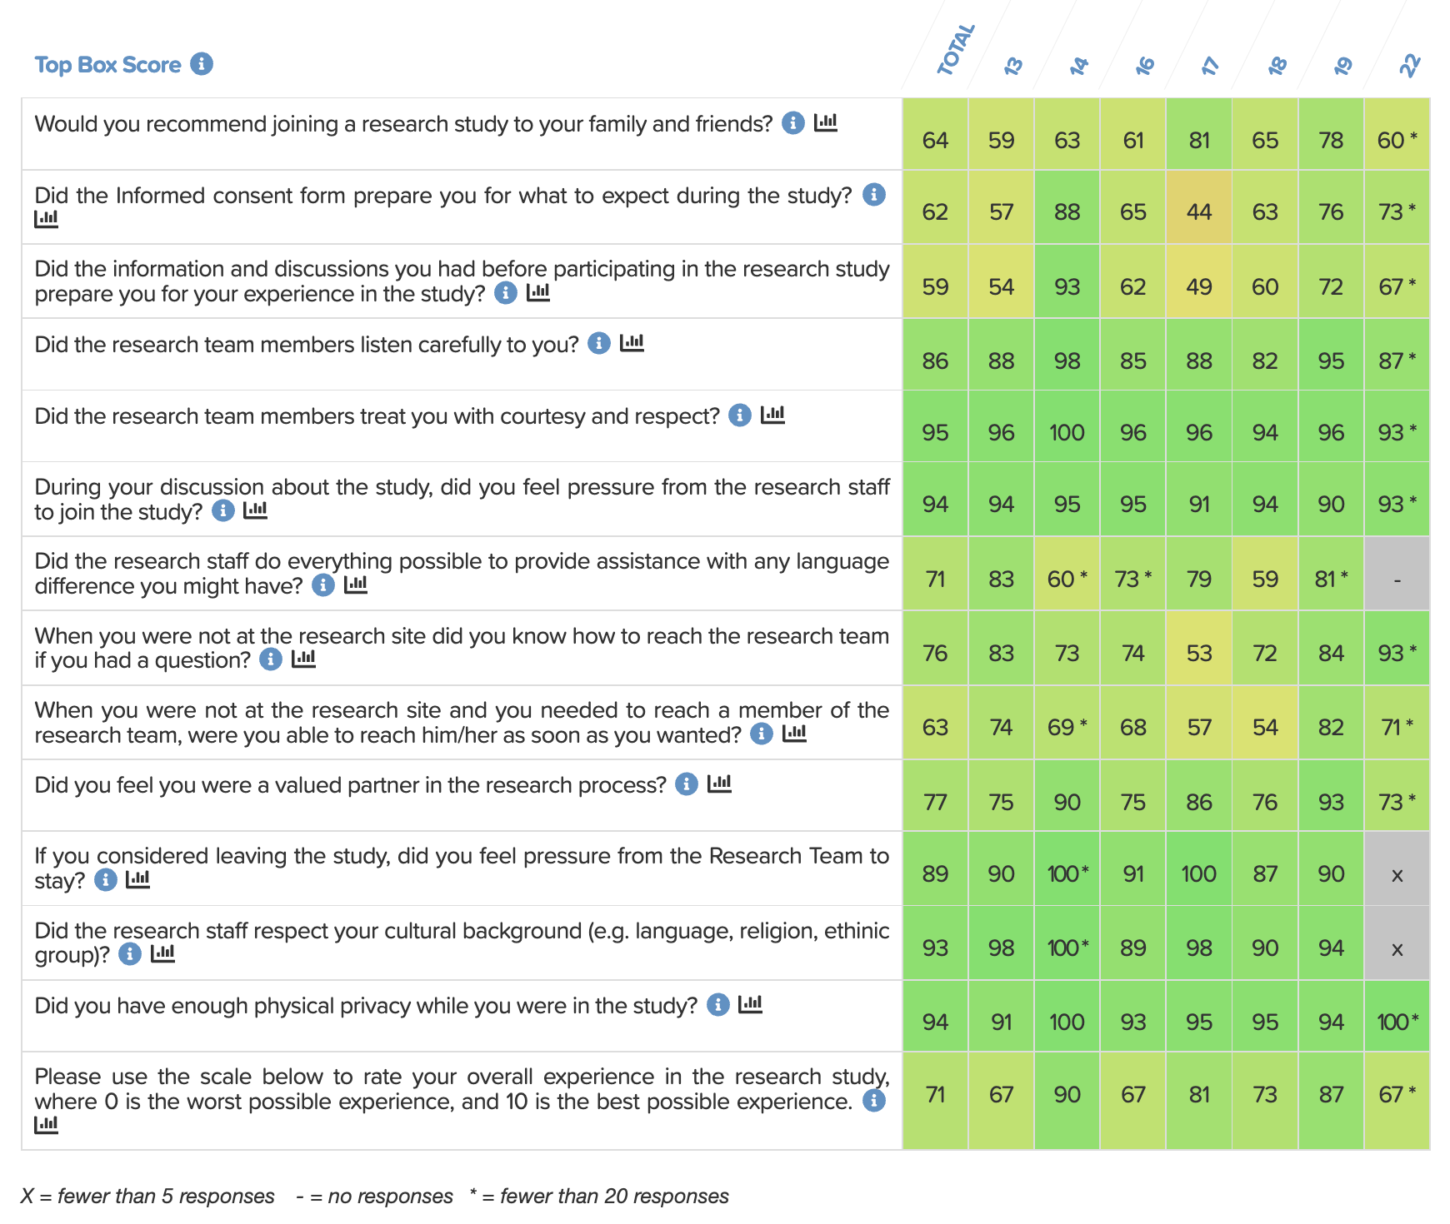
Consortium Dashboard View
Supported in part by NIH/NCATS Grant # U01TR003206

Slide 14
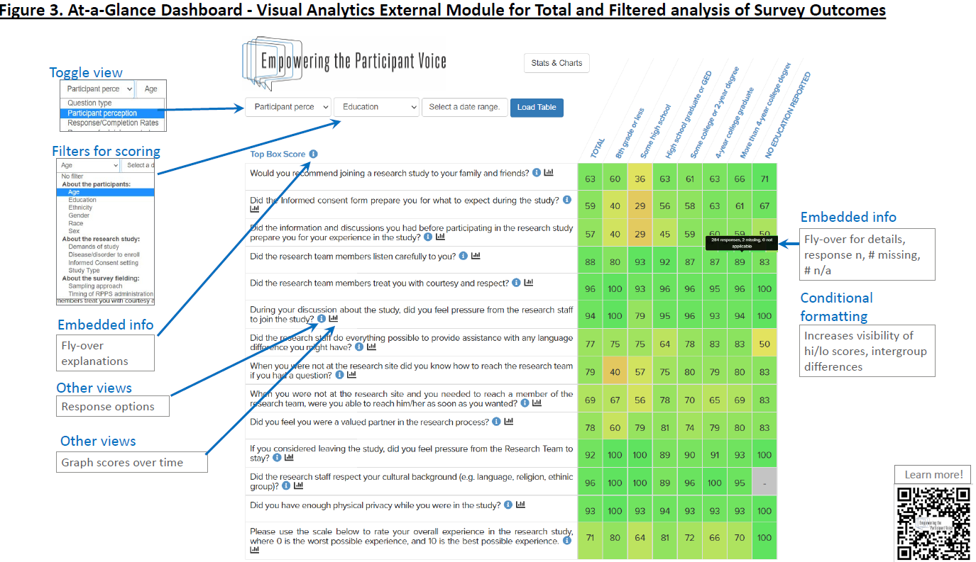

Slide 15
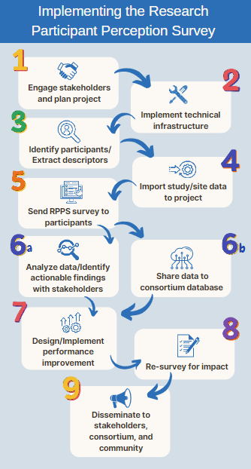
Implementation
Supported in part by NIH/NCATS Grant # U01TR003206

Slide 16
Technical Setup Checklist, RPPS/REDCap
Install or update REDCap to version 10.0 or later
Create an EPV RPPS Project in REDCap
Create a Research Study Database Project in REDCap (Optional)
Create an Intra-Institutional Aggregator Project in REDCap (Optional)
Connect your institution’s RPPS Project with the EPV Consortium Database
Install REDCap external modules:
EPV At-a-Glance Dashboard module 1.7 or later
Multilingual 1.9.8 or later
Cross project piping 1.4.5 or later (Only if using a Research Study Database Project in REDCap)

Slide 17
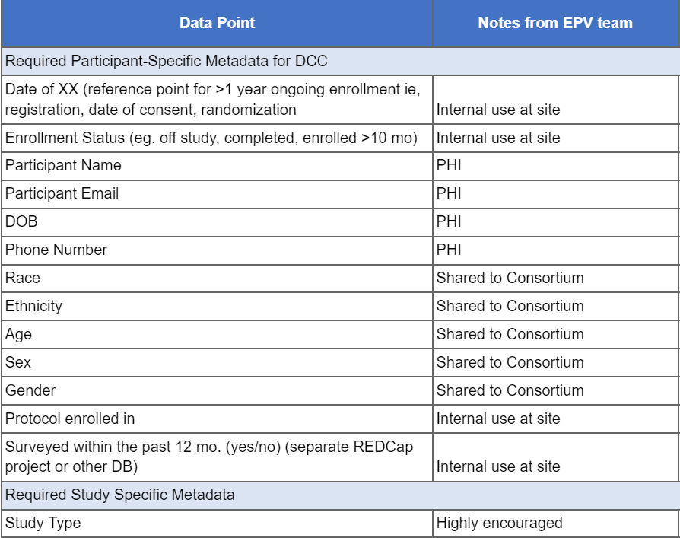
Collecting Participant Descriptors

Slide 18
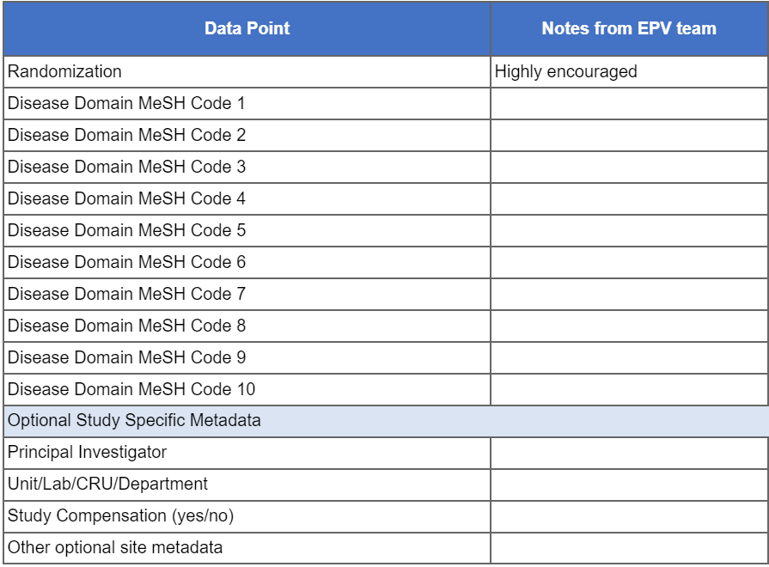
Collecting Study Descriptors

Slide 19
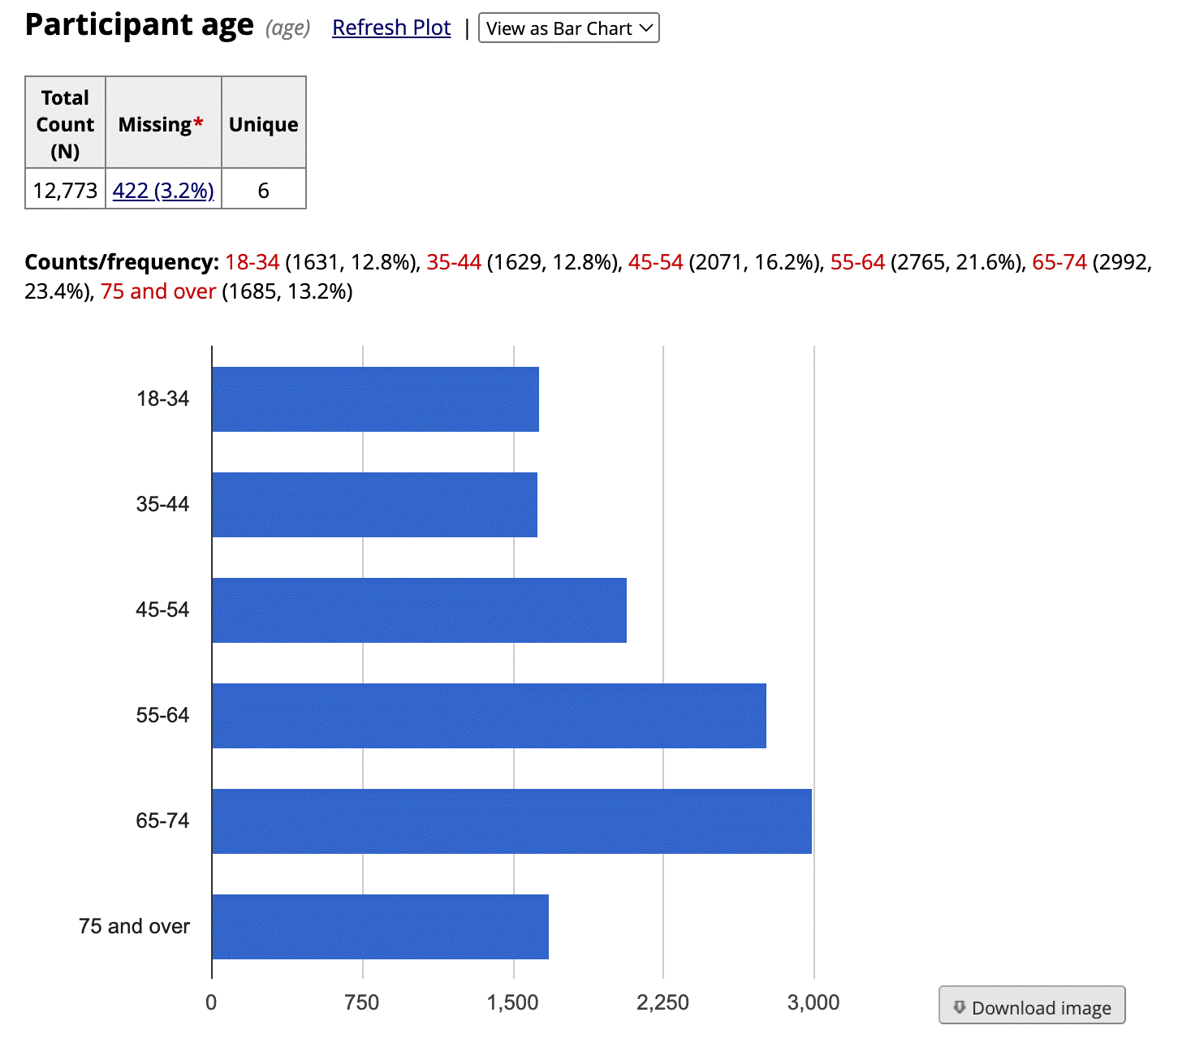
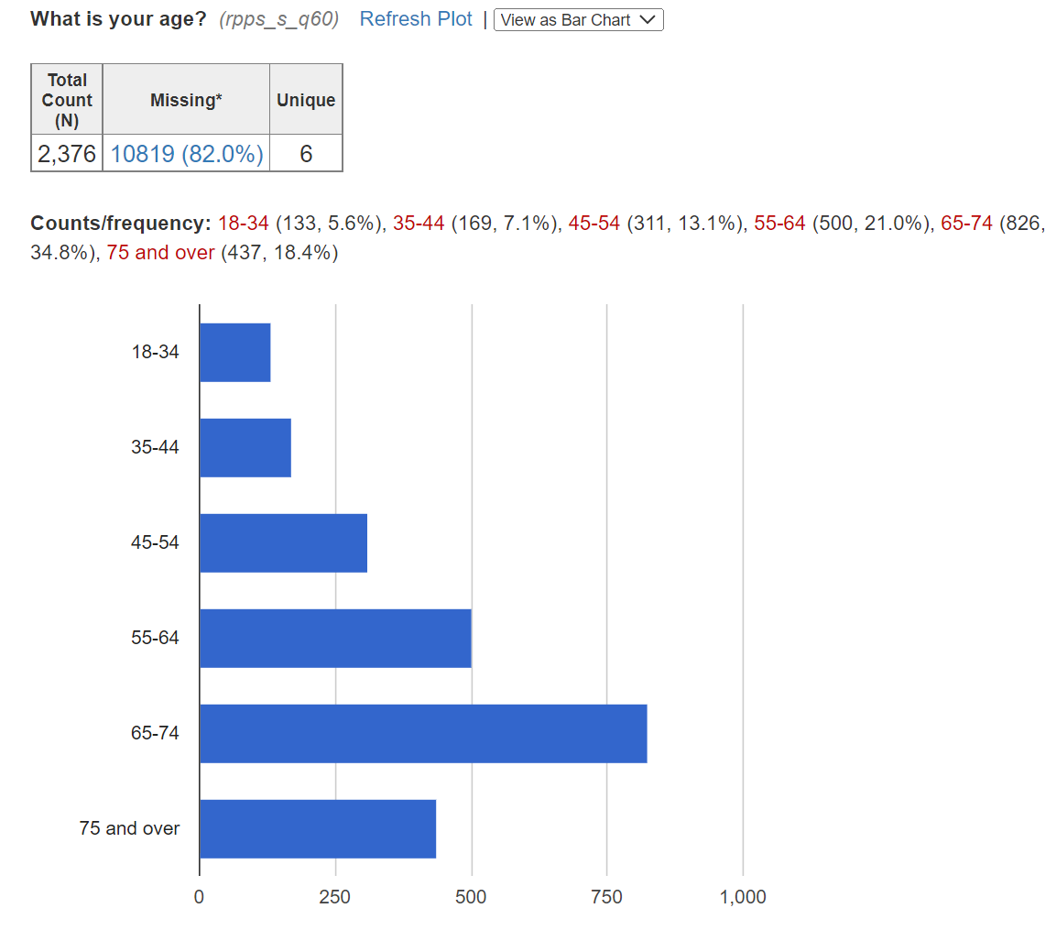
Recipients Vs. Responders
Notes:
Value of collecting participant descriptors

Slide 20
Summarizing Effort
Institutional Set-Up and Initial Implementation - total hours through the first fielding | Effort
Leadership | 17-56 hours
Project Manager | 50-100 hours
Institutional Maintenance and Program Management - hrs/week
Leadership | 2-3 hr/week
Project manager | 4-9 hr/week
Technical Set-up Tasks - per project
Leadership | 0-10 hours, Initial technical set up
Project manager | 0-19 hours Initial technical set up
IT & REDCap combined | 45 hours Initial technical set up
Ongoing Survey Administration - per fielding
Leadership | 1 hr/survey fielding
Project manager | 0-20 hr/survey fielding (high end, when tasks overlap REDCap specialist)
IT/REDCap functions combined | 10-15 hr/survey fielding

Slide 21
Collect and Analyze RPPS data
Design Improvement
Implement Change
Include Stakeholders (Participants, Staff,
Identify risk points prospectively
Measure
Using the data
Supported in part by NIH/NCATS Grant # U01TR003206

Slide 22
Questions

Slide 23
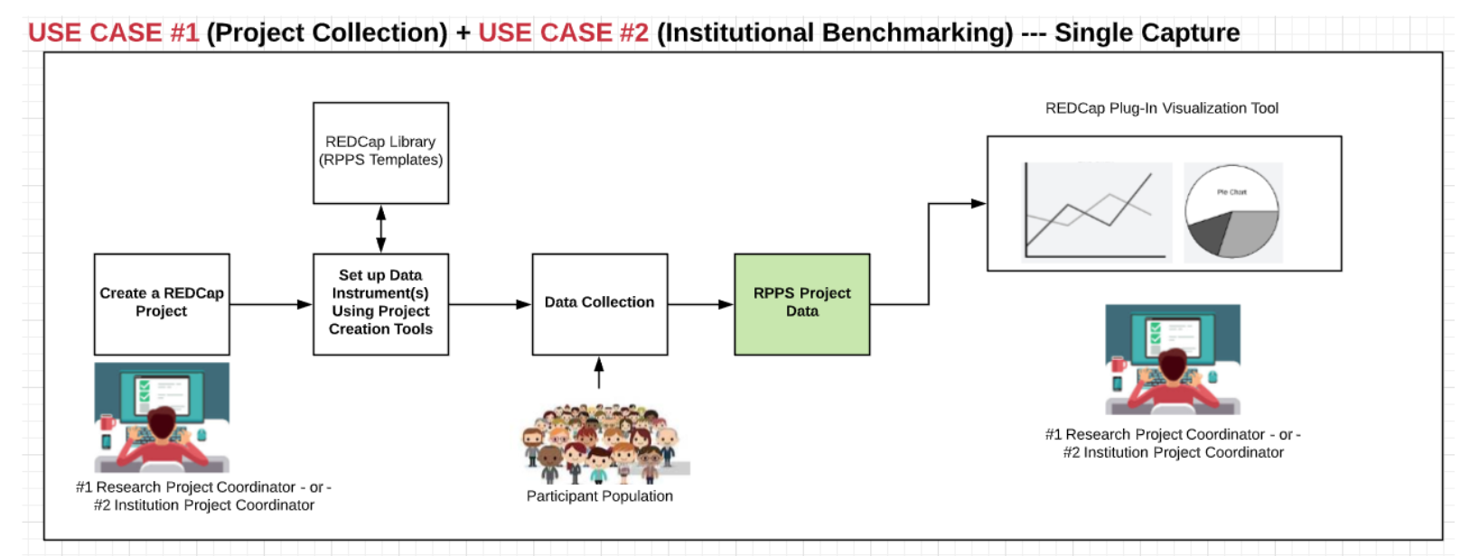
Data flow model: Use Cases 1 & 2
Field through email/REDCap survey fxn
Study characteristics from CTMS
CTMS/EMR/Other
Participant contact and study information
Notes:
HOW………..

Slide 24
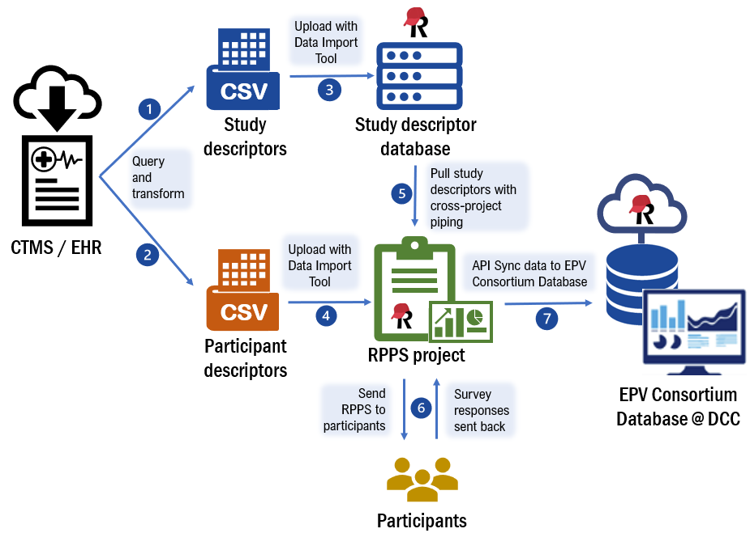

Slide 25
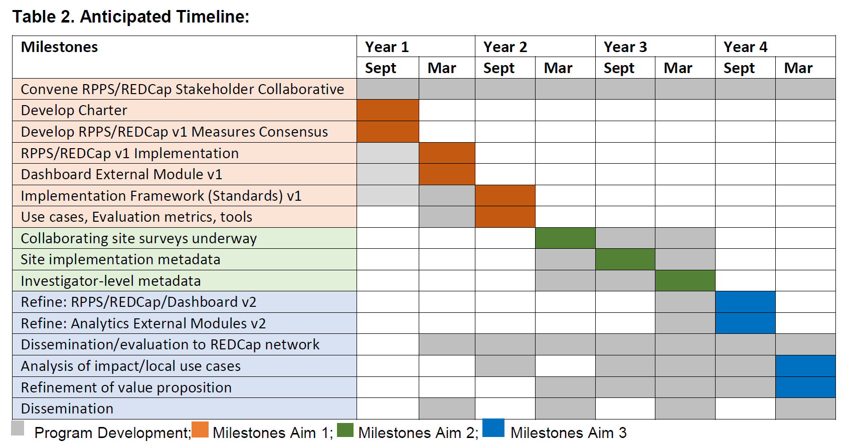
Where are we now?
Supported in part by NIH/NCATS Grant # U01TR003206

Slide 26
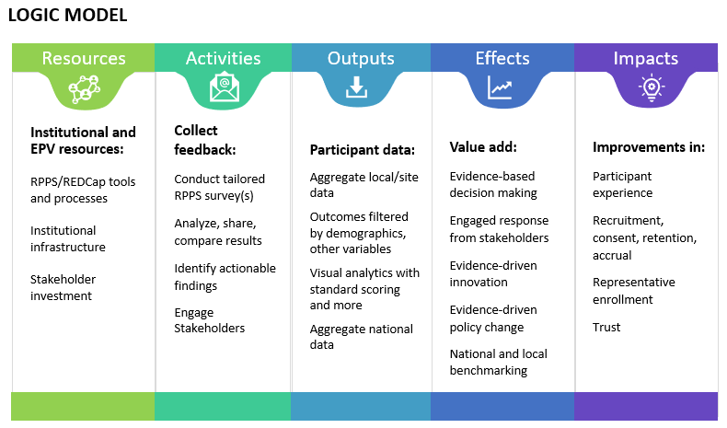
Supported in part by NIH/NCATS Grant # U01TR003206

